Slide 1
Competition Bridge Tester
Carter Mealey
Ben Holleran
Notes:
General introduction type stuff.

Slide 2
What We Will Discuss
The background of the course and project
Our solution
System diagrams
Areas of responsibility
Rough Timeline
Rough Budget

Slide 3
Course Background
Student design project
Vermont Technical College senior projects
Select project from list provided
Communicate with client to determine specs
Create design to meet specs
Review design with client and project managers
Create new specs and adjust design direction
Revise design to reflect changes
Build design while working with client
Final presentation
Notes:
The course that we are part
Let me tell you a little bit about the

Slide 4
Project Background
Selected project: Bridge Tester
Design and build testing equipment compatible with Trotski Competition
Design project to be open source
Budget | $7000
Clients | John Diebold Gordon Reynolds

Slide 5
Preliminary Specs
1 meter Span – Trotski Competition
5 Tons – Current Record 3.2 Tons
Movable by Two People
Displays Load on Large Display
Accurate to 1% Load
Precise to 1 lb During competition
8” Piston Throw

Slide 6
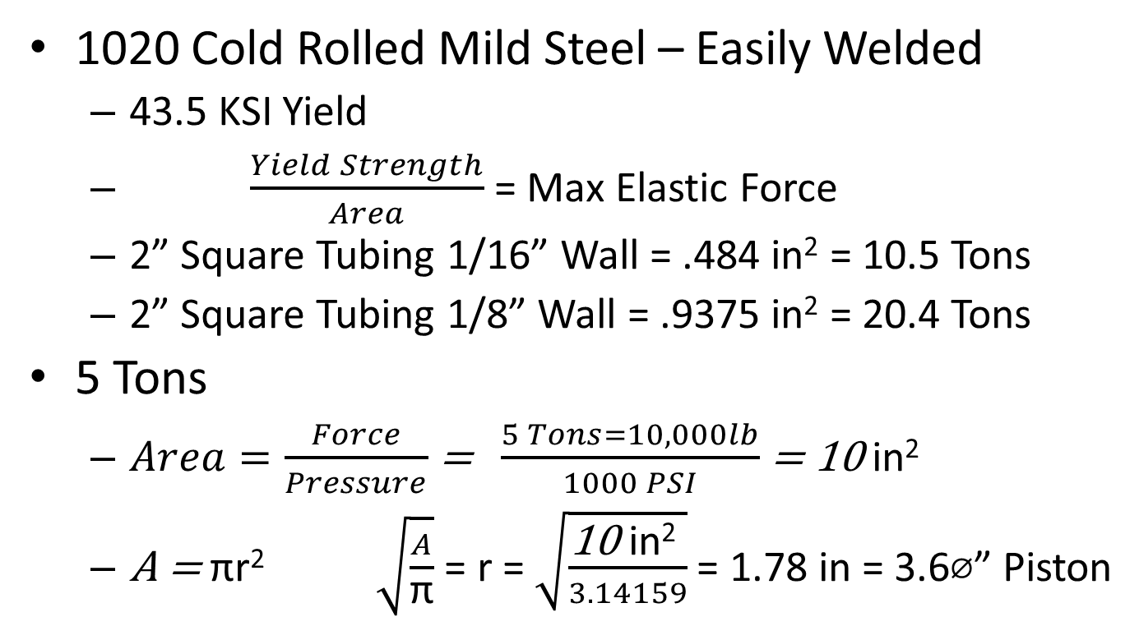
Preliminary Calculations
1020 Cold Rolled Mild Steel – Easily Welded
43.5 KSI Yield
$\frac{Yield Strength}{Area}$ = Max Elastic Force
2” Square Tubing 1/16” Wall = .484 in² = 10.5 Tons
2” Square Tubing 1/8” Wall = .9375 in² = 20.4 Tons
5 Tons
$Area=\frac{Force}{Pressure}$ = $\frac{5 Tons=10,000lb}{1000 PSI}$ = 10 in²
A = πr² $\sqrt{\frac{A}{\text{π}}}$ = r = $\sqrt{\frac{\text{10 }\text{in}\text{2} }{3.14159}}$ = 1.78 in = 3.6⌀” Piston

Slide 7
Preliminary Design
Hydraulic Cylinder
Truss instead of I-Beam to save weight
3” LED 7 segment display for load
Raspberry Pi as controller
Power of a computer
Individually controlled pins like a microcontroller
HDMI monitor for force over deflection readout
Web interface to download logs.

Slide 8
Large 7-Segment Display
LCD Screen
Hydraulic
Cylinder
HDMI Cord
8888
Pressure
Line
Bridge Goes Here
Control box:
Raspberry Pi
I2C A2D
Switches
GPIO Interface
Hydraulic Pump
2in x 2in Hollow
Steel Tubing Frame

Slide 9
Areas of Responsibility
 | Ben | Carter
Mechanical | Hydraulics | Frame
Electrical | Raspberry Pi & Controls | 7-Segment Display
Software | I2C Sensors Interface | Graphical Interface

Slide 10
Rough Timeline
Week | 1/13/2014 | 1/20/2014 | 1/27/2014 | 2/3/2014 | 2/10/2014 | 2/17/2014 | 2/24/2014 | 3/3/2014 | 3/10/2014 | 3/17/2014 | 3/24/2014 | 3/31/2014 | 4/7/2014 | 4/14/2014 | 4/21/2014 | 4/28/2014 | 5/5/2014
Hydraulics
Spec parts | x | x
Purchase | x | x | x | x
Assemble |  |  | x | x | x | x | x | x
Attach to frame |  |  |  |  |  |  | x | x | x
Calibrate |  |  |  |  |  |  |  |  |  | x |  |  |  |  | x | x
Frame
Design | x | x
Purchase |  | x | x | x
Fabricate |  |  |  | x | x | x | x
Assemble |  |  |  |  |  | x | x | x | x
Raspberry Pi
Purchase | x
Install Raspbian OS |  | x
Program with Python |  |  | x | x | x | x
Interface |  |  |  | x | x | x | x | x | x | x
Attach to Frame |  |  |  |  |  |  |  |  |  |  | x | x | x | x

Slide 11
Preliminary Budget
Name | Link | Qt | Price | Total
Electronics |  |  |  |  | $ 394.99
7 segment display |  | 10 | $ 2.50 | $ 24.99
Rasberry Pi |  | 1 | $ 50.00 | $ 50.00
Monitor |  | 1 | $ 100.00 | $ 100.00
hdmi cord |  | 1 | $ 20.00 | $ 20.00
i2c ADC |  | 5 | $ 4.00 | $ 20.00
Switches |  | 6 | $ 5.00 | $ 30.00
Misc |  | 1 | $ 150.00 | $ 150.00
 |  |  |  | $ -
 |  |  |  | $ -
Hydrolics |  |  |  |  | $ 1,028.00
Pump |  | 1 | $ 100.00 | $ 100.00
Motor |  | 1 | $ 100.00 | $ 100.00
Cylinder |  | 1 | $ 236.50 | $ 236.50
Sensor |  | 1 | $391.50 | $ 391.50
Lines |  | 2 | $ 100.00 | $ 200.00
 |  |  |  | $ -
Mechanical |  |  |  |  | $ 340.00
Castors |  | 4 | $ 10.00 | $ 40.00
Misc Hardware |  | 1 | $ 300.00 | $ 300.00
 |  |  |  | $ -
Raw Materials |  |  |  |  | $ 498.00
Frame Steel |  | 10 | $ 42.00 | $ 420.00
Paint |  | 4 | $ 7.00 | $ 28.00
Aluminum plate |  | 1 | $ 50.00 | $ 50.00
Category | Total
Electronics | $ 394.99
Hydrolics | $ 1,028.00
Mechanical | $ 340.00
Raw Materials | $ 498.00
Total | $ 2,260.99

Slide 12
Conclusion
In Conclusion:
Design meets Course specs
Design meets Client specs
Design is constructible within timeframe
Design is within budget

Slide 13
Questions?

